Slide 1
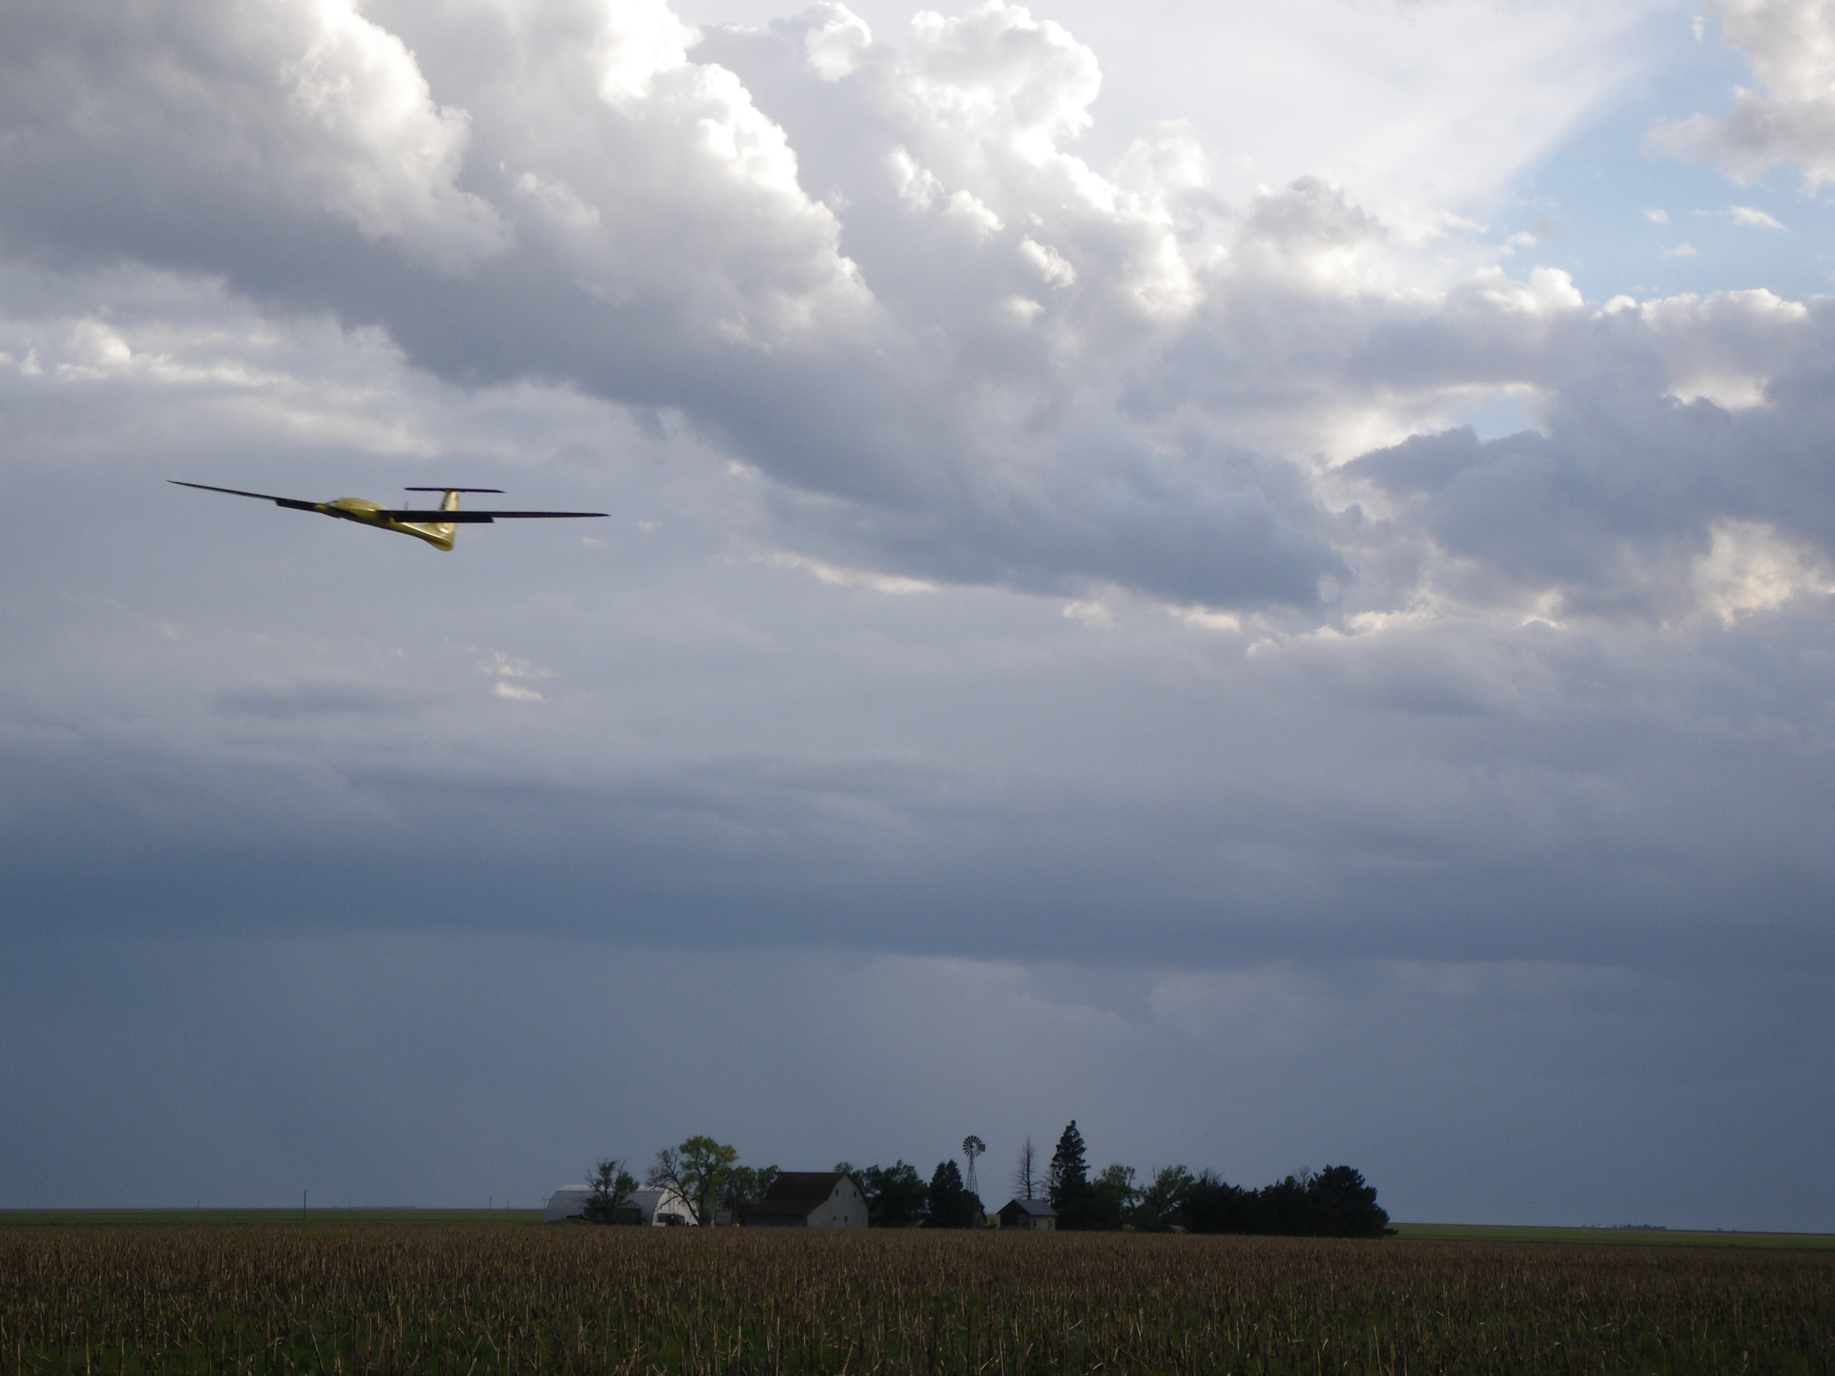
Chapter 9
Nonlinear Design Models

Slide 2
Architecture

Slide 3
Simplifying Dynamic Models
When designing higher level autopilot functions, we need models that are easier to analyze and simulate
Models must capture the essential behavior of system
We will derive reduced-order, reduced-complexity models suitable for design of higher-level guidance strategies
Two types of guidance models:
Kinematic – utilize kinematic relationships, do not consider aerodynamics, forces directly
Dynamic – apply force balance relations to point-mass models

Slide 4
Autopilot Models (transfer function)
Notes:
Airspeed hold and roll hold loops can be modeled as:
\[
V_a(s) = \frac{{\color{magenta}b_{V_a}}}{s+{\color{magenta}b_{V_a}}}{\color{blue}V_a^c}(s) \qquad\qquad
\phi(s) = \frac{{\color{magenta}b_{\phi}}}{s+{\color{magenta}b_{\phi}}}{\color{blue}\phi^c}(s)
\]
Altitude and course hold loops can be modeled as:
\[
h(s) = \frac{{\color{magenta}b_{\dot{h}}}s+{\color{magenta}b_h}}{s^2 +
{\color{magenta}b_{\dot{h}}}s + {\color{magenta}b_h}}{\color{blue}h^c}(s) \qquad\qquad
\chi(s) = \frac{{\color{magenta}b_{\dot{\chi}}}s + {\color{magenta}b_{\chi}}}
{s^2 + {\color{magenta}b_{\dot{\chi}}}s + {\color{magenta}b_{\chi}}}{\color{blue}\chi^c}(s)
\]
Alternatively, the heading hold loop can be modeled as:
\[
\psi(s) = \frac{{\color{magenta}b_{\dot{\psi}}}s + {\color{magenta}b_{\psi}}}
{s^2 + {\color{magenta}b_{\dot{\psi}}}s + {\color{magenta}b_{\psi}}}{\color{blue}\psi^c}(s)
\]
Flight-path angle and load factor loops can be modeled as:
\[
\gamma(s) = \frac{{\color{magenta}b_{\gamma}}}{s+{\color{magenta}b_{\gamma}}}{\color{blue}\gamma^c}(s) \qquad\qquad
n_{\mathit{lf}}(s) = \frac{{\color{magenta}b_n}}{s+{\color{magenta}b_n}}{\color{blue}n_{\mathit{lf}}^c}(s)
\]

Slide 5
Autopilot Models
Notes:
Airspeed hold and roll hold loops can be modeled as:
\begin{align*}
\dot{V}_a &= {\color{magenta}b_{V_a}}({\color{blue}V_a^c} - V_a) \\
\dot{\phi} &= {\color{magenta}b_{\phi}}({\color{blue}\phi^c} - \phi)
\end{align*}
Altitude and course hold loops can be modeled as:
\begin{align*}
\ddot{h} &= {\color{magenta}b_{\dot{h}}}(\dot{h}^c - \dot{h}) + {\color{magenta}b_h}({\color{blue}h^c}-h) \\
\ddot{\chi} &= {\color{magenta}b_{\dot{\chi}}}(\dot{\chi}^c-\dot{\chi}) + {\color{magenta}b_{\chi}}({\color{blue}\chi^c} - \chi)
\end{align*}
Alternatively, the heading hold loop can be modeled as:
\[
\ddot{\psi} = {\color{magenta}b_{\dot{\psi}}}(\dot{\psi}^c-\dot{\psi}) + {\color{magenta}b_{\psi}}({\color{blue}\psi^c} - \psi)
\]
Flight-path angle and load factor loops can be modeled as:
\begin{align*}
\dot{\gamma} &= {\color{magenta}b_{\gamma}}({\color{blue}\gamma^c} - \gamma) \\
\dot{n}_{\mathit{lf}} &= {\color{magenta}b_n} ({\color{blue}n_{\mathit{lf}}^c} - n_{\mathit{lf}})
\end{align*}

Slide 6
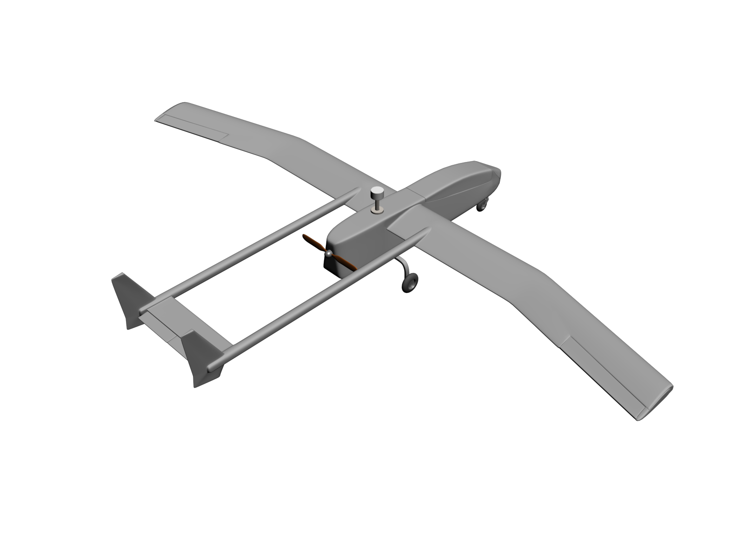
Kinematic Model of Controlled Flight
horizontal component
of groundspeed vector
Flight path projected onto ground
Notes:
\noindent The velocity vector can be written as
\[
\mathbf{V}_g^i = V_g \begin{pmatrix} \cos\chi\cos\gamma \\ \sin\chi\cos\gamma \\ -\sin\gamma \\\end{pmatrix}
\]
which gives:
\[
\begin{pmatrix} \dot{p}_n \\ \dot{p}_e \\ \dot{h} \end{pmatrix}
= V_g \begin{pmatrix}
\cos\chi\cos\gamma \\
\sin\chi\cos\gamma \\
\sin\gamma
\end{pmatrix}
\]
Alternatively, using the Wind Triangle:
\[
\begin{pmatrix} \dot{p}_n \\ \dot{p}_e \\ \dot{h} \end{pmatrix}
= V_a \begin{pmatrix}
\cos\psi\cos\gamma_a \\
\sin\psi\cos\gamma_a \\
\sin\gamma_a
\end{pmatrix} + \begin{pmatrix} w_n \\ w_e \\ -w_d \end{pmatrix}
\]

Slide 7
Kinematic Model of Controlled Flight
horizontal component
of groundspeed vector
Flight path projected onto ground
Notes:
\noindent Beginning with
\[
\begin{pmatrix} \dot{p}_n \\ \dot{p}_e \\ \dot{h} \end{pmatrix}
= V_a \begin{pmatrix}
\cos\psi\cos\gamma_a \\
\sin\psi\cos\gamma_a \\
\sin\gamma_a
\end{pmatrix} + \begin{pmatrix} w_n \\ w_e \\ -w_d \end{pmatrix}
\]
\noindent
and assuming level flight, i.e., $\gamma_a=0$, \\
and no down component of wind, \\
i.e., $w_d=0$:
\[
\begin{pmatrix} \dot{p}_n \\ \dot{p}_e \\ \dot{h} \end{pmatrix}
= V_a \begin{pmatrix}
\cos\psi \\
\sin\psi \\
0
\end{pmatrix} + \begin{pmatrix} w_n \\ w_e \\ 0 \end{pmatrix}
\]
This equation is typically called the Dubin’s car model.

Slide 8
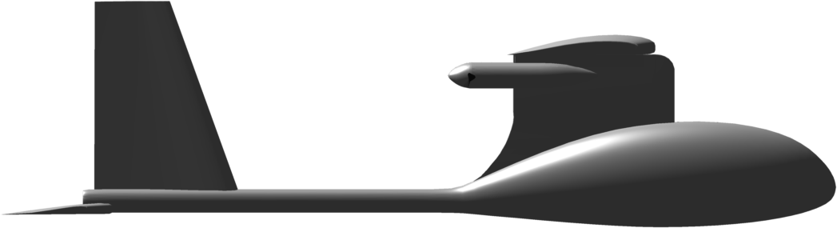
Coordinated Turn
Differentiate both sides of
vector wind-triangle equation (2.9). Solve resulting messy matrix
equation.
Notes:
From Chapter 2 we have
\[
\dot\chi = \frac{g}{V_g}\tan\phi\cos(\chi-\psi)
\]
For constant-altitude flight with no down component of wind:
\begin{align*}
\dot{V}_g &= \frac{\dot{V}_a}{\cos(\chi-\psi)} + V_g\dot{\chi}\tan(\chi-\psi) \label{eq:nonlinear-Vg-dot}\\
\dot{\psi} &= \frac{\dot{V}_a}{V_a}\tan(\chi-\psi) + \frac{V_g\dot{\chi}}{V_a\cos(\chi-\psi)}
\end{align*}
If airspeed is constant, then we get the standard coordinated turn condition
\[
\dot\psi = \frac{g}{V_a}\tan\phi
\]
which is true even if when $w_n, w_e \neq 0$.

Slide 9
Accelerating Climb
Notes:
Summing forces gives
\[
F_{\text{lift}}\cos\phi = \mass V_g\dot\gamma + \mass g\cos\gamma
\]
Solving for $\dot\gamma$:
\[
\dot\gamma = \frac{g}{V_g}\left( \frac{F_{\text{lift}}}{\mass g}\cos\phi - \cos\gamma\right)
\]
The load factor (often expressed in $g$’s) is defined as
\[
n_{\mathit{lf}}\defeq F_{\text{lift}}/\mass g.
\]
Note that for wings level, horizontal flight $n_{\mathit{lf}}=1$. Therefore
\[
\dot\gamma = \frac{g}{V_g}\left( n_{\mathit{lf}}\cos\phi - \cos\gamma\right)
\]
In a constant climb where $\dot{\gamma} = 0$, we have $n_{\mathit{lf}} = \frac{\cos\gamma}{\cos\phi}$.

Slide 10
Kinematic Guidance Models
Several guidance models can be derived, with varying levels of fidelity
Choice of model depends on application

Slide 11
Kinematic Guidance Model - #1a
Notes:
\noindent
The simplest model (and the one used in Chapters 10, 11, 12) is given by
\begin{align*}
\dot{p}_n &= V_a \cos{\color{red}\psi} + {\color{blue}w_n} \\
\dot{p}_e &= V_a \sin{\color{red}\psi} + {\color{blue}w_e} \\
\ddot{\chi} &= b_{\dot{\chi}}(\dot{\chi}^c-\dot{\chi}) + b_{\chi}({\color{blue}\chi^c}-\chi) \\
\ddot{h} &= b_{\dot{h}}(\dot{h}^c - \dot{h}) + b_h({\color{blue}h^c}-h) \\
\dot{V_a} &= b_{V_a} ({\color{blue}V_a^c} - V_a)
\end{align*}
where $\psi$ is given by (equation (2.12))
\[
{\color{red}\psi} = \chi - \sin^{-1}\left(\frac{1}{V_a}\begin{pmatrix}w_n \\ w_e\end{pmatrix}^{\top}\begin{pmatrix}-\sin\chi \\ \cos\chi\end{pmatrix}\right)
\]

Slide 12
Kinematic Guidance Model - #1b
Notes:
\noindent
If the autopilot is designed to command heading instead of course, then the model becomes
\begin{align*}
\dot{p}_n &= V_a \cos\psi + {\color{blue}w_n} \\
\dot{p}_e &= V_a \sin\psi + {\color{blue}w_e} \\
\ddot{\psi} &= b_{\dot{\psi}}(\dot{\psi}^c-\dot{\psi}) + b_{\psi}({\color{blue}\psi^c}-\psi) \\
\ddot{h} &= b_{\dot{h}}(\dot{h}^c - \dot{h}) + b_h({\color{blue}h^c}-h) \\
\dot{V_a} &= b_{V_a} ({\color{blue}V_a^c} - V_a)
\end{align*}

Slide 13
Kinematic Guidance Models - #2a
Notes:
\noindent
A more accurate model is to command the roll angle and use the coordinated turn model for $\chi$:
\begin{align*}
\dot{p}_n &= V_a \cos{\color{red}\psi} + {\color{blue}w_n} \\
\dot{p}_e &= V_a \sin{\color{red}\psi} + {\color{blue}w_e} \\
\dot\chi &= \frac{g}{{\color{red}V_g}}\tan\phi \cos(\chi-{\color{red}\psi})\\
\ddot{h} &= b_{\dot{h}}(\dot{h}^c - \dot{h}) + b_h({\color{blue}h^c}-h) \\
\dot{V_a} &= b_{V_a} ({\color{blue}V_a^c} - V_a) \\
\dot\phi &= b_{\phi} ({\color{blue}\phi^c}-\phi)
\end{align*}
where $\psi$ and $V_g$ are given by (equations (2.10) and (2.12))
\begin{align*}
{\color{red}\psi} &= \chi - \sin^{-1}\left(\frac{1}{V_a}\begin{pmatrix}w_n \\ w_e\end{pmatrix}^{\top}\begin{pmatrix}-\sin\chi \\ \cos\chi\end{pmatrix}\right) \\
{\color{red}V_g} &= w_n\cos\chi+w_e\sin\chi + \sqrt{(w_n\cos\chi+w_e\sin\chi)^2+V_a^2-w_n^2-w_e^2}
\end{align*}

Slide 14
Kinematic Guidance Models - #2b
Notes:
\noindent
Or, in terms of heading we have
\begin{align*}
\dot{p}_n &= V_a \cos\psi + {\color{blue}w_n} \\
\dot{p}_e &= V_a \sin\psi + {\color{blue}w_e} \\
\dot\psi &= \frac{g}{V_a}\tan\phi\\
\ddot{h} &= b_{\dot{h}}(\dot{h}^c - \dot{h}) + b_h({\color{blue}h^c}-h) \\
\dot{V_a} &= b_{V_a} ({\color{blue}V_a^c} - V_a) \\
\dot\phi &= b_{\phi} ({\color{blue}\phi^c}-\phi)
\end{align*}
where $\chi$ and $V_g$ are computed from the wind triangle if needed by the autopilot

Slide 15
Kinematic Guidance Models - #3
Notes:
\noindent
More accurate still is to command the flight path angle
\begin{align*}
\dot{p}_n &= V_a \cos\psi\cos{\color{red}\gamma_a} + {\color{blue}w_n} \\
\dot{p}_e &= V_a \sin\psi\cos{\color{red}\gamma_a} + {\color{blue}w_e} \\
\dot{h} &= V_a \sin{\color{red}\gamma_a} - {\color{blue}w_d} \\
\dot\psi &= \frac{g}{V_a}\tan\phi \\
\dot\gamma &= b_{\gamma}({\color{blue}\gamma^c}-\gamma) \\
\dot{V_a} &= b_{V_a} ({\color{blue}V_a^c} - V_a) \\
\dot\phi &= b_{\phi} ({\color{blue}\phi^c}-\phi)
\end{align*}
where $\gamma_a$ is given by equation (2.11)
\[
{\color{red}\gamma_a} = \sin^{-1}\left( \frac{V_g\sin\gamma+w_d}{V_a} \right)
\]
and $\chi$ and $V_g$ are computed from the wind triangle if needed by the autopilot

Slide 16
Kinematic Guidance Models - #4
Notes:
More accurate still is to command the load factor
\begin{align*}
\dot{p}_n &= V_a \cos\psi\cos{\color{red}\gamma_a} + {\color{blue}w_n} \\
\dot{p}_e &= V_a \sin\psi\cos{\color{red}\gamma_a} + {\color{blue}w_e} \\
\dot{h} &= V_a \sin{\color{red}\gamma_a} -w_d \notag \\
\dot\psi &= \frac{g}{V_a}\tan\phi\\
\dot\gamma &= \frac{g}{V_g}\left( n_{\mathit{lf}}\cos\phi - \cos\gamma\right) \notag \\
\dot{V_a} &= b_{V_a} ({\color{blue}V_a^c} - V_a) \notag \\
\dot\phi &= b_{\phi} ({\color{blue}\phi^c}-\phi) \notag \\
\dot{n}_{\mathit{lf}} &= b_n ({\color{blue}n_{\mathit{lf}}^c}-n_{\mathit{lf}})
\end{align*}
where $\chi$, $V_g$, and $\gamma_a$ are computed from the wind triangle

Slide 17
Dynamic Guidance Models
Notes:
The ground speed and course dynamics can be expressed as
\[
\dot{V_g} = \frac{F_{\text{thrust}}}{\mass} - \frac{F_{\text{drag}}}{\mass} -g\sin\gamma
\]
and
\begin{align*}
\dot{\chi} &= \frac{g}{V_g}\tan\phi\cos(\chi-\psi) \\
&= \frac{g}{V_g}\frac{\sin\phi\cos(\chi-\psi)}{\cos\gamma}n \\
&= \frac{F_{\text{lift}}}{\mass V_g}\frac{\sin\phi\cos(\chi-\psi)}{\cos\gamma}
\end{align*}

Slide 18
Dynamic Guidance Models
Notes:
The dynamic guidance model is therefore
\begin{alignat*}{2}
\dot{p}_n &= V_g \cos\chi\cos\gamma &\qquad& F_{\text{lift}} =\frac{1}{2}\rho {\color{red}V_a}^2S{\color{blue}C_L} \\
\dot{p}_e &= V_g \sin\chi\cos\gamma &\qquad& F_{\text{drag}} =\frac{1}{2}\rho {\color{red}V_a}^2SC_D\\
\dot{h} &= V_g \sin\gamma &\qquad& C_D = C_{D_0}+K{\color{blue}C_L}^2 \\
\dot{V_g} &= \frac{{\color{blue}F_{\text{thrust}}}}{\mass} - \frac{F_{\text{drag}}}{\mass} -g\sin\gamma &\qquad& E_{\text{max}}\defeq\left( \frac{F_{\text{lift}}}{F_{\text{drag}}} \right)_{\text{max}} \\
\dot\chi &= \frac{F_{\text{lift}}}{\mass V_g}\frac{\sin{\color{blue}\phi}\cos(\chi-{\color{red}\psi})}{\cos\gamma} &\qquad& K = \frac{1}{4 E_{\text{max}}^2 C_{D_0}} \\
\dot\gamma &= \frac{F_{\text{lift}}}{\mass V_g}\cos{\color{blue}\phi} - \frac{g}{V_g}\cos\gamma &\qquad &
\end{alignat*}
where $V_a$ and $\psi$ are computed from the wind triangle as
\begin{align*}
V_a &= \sqrt{
V_g^2 - 2V_g\begin{pmatrix}\cos\chi\cos\gamma \\ \sin\chi\cos\gamma \\
-\sin\gamma\end{pmatrix}^{\top}\begin{pmatrix} w_n \\ w_e \\ w_d \end{pmatrix}
+ V_w^2} \\
\psi &= \chi -\!\sin^{-1}\left(\frac{1}{V_a\cos\gamma_a} \begin{pmatrix}
w_n \\
w_e
\end{pmatrix}^{\top} \begin{pmatrix}
-\!\sin \chi \\
\cos \chi
\end{pmatrix}\right).
\end{align*}

Slide 19
Dynamic Guidance Models
Notes:
In the no wind case we have
\begin{alignat*}{2}
\dot{p}_n &= V_a \cos\psi\cos\gamma &\qquad&
F_{\text{lift}} =\frac{1}{2}\rho V_a^2S{\color{blue}C_L} \\
\dot{p}_e &= V_a \sin\psi\cos\gamma &\qquad&
F_{\text{drag}} =\frac{1}{2}\rho V_a^2SC_D \\
\dot{h} &= V_a \sin\gamma &\qquad&
C_D = C_{D_0}+K{\color{blue}C_L}^2\\
\dot{V_a} &= \frac{{\color{blue}F_{\text{thrust}}}}{\mass} - \frac{F_{\text{drag}}}{\mass} -g\sin\gamma &\qquad&
E_{\text{max}}\defeq\left( \frac{F_{\text{lift}}}{F_{\text{drag}}} \right)_{\text{max}}\\
\dot\psi &= \frac{F_{\text{lift}}}{\mass V_a}\frac{\sin{\color{blue}\phi}}{\cos\gamma}&\qquad&
K = \frac{1}{4 E_{\text{max}}^2 C_{D_0}}\\
\dot\gamma &= \frac{F_{\text{lift}}}{\mass V_a}\cos{\color{blue}\phi} - \frac{g}{V_a}\cos\gamma
\end{alignat*}
Inputs are thrust, lift coefficient, and bank angle.

